Slide 1

Data Access
Asst.Prof.Dr.Derya BİRANT
328 - Web Based Windows Programming

Slide 2
Contents
1
What is ADO.NET?
2
ADO.NET Fundamentals
3
ADO.NET Architecture
4
ADO.NET Data Providers
5
The ADO.NET Namespace
6
Connection Strings and Pooling
7
The Command Class

Slide 3
What is ADO.NET?
The .NET Framework includes its own data access technology: ADO.NET
ADO.NET consists of managed classes that allow .NET applications to connect to data sources (usually relational databases), execute commands, and manage data.

Slide 4

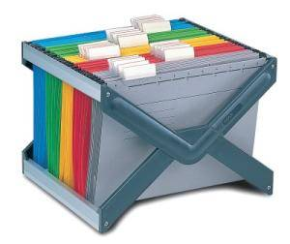

ADO.NET
Developers use ADO.NET data classes
  to interact with relational databases
  to interact with the file system
  to read XML documents
ADO.NET deals with the challenge of different data sources.

Slide 5


ADO.NET Fundamentals
Programmers use a generic set of objects no matter what the underlying data source is.
For example:
  You can use the same connection class
    to retrieve a record from an Oracle database
    to tackle the task with SQL Server
    …

Slide 6
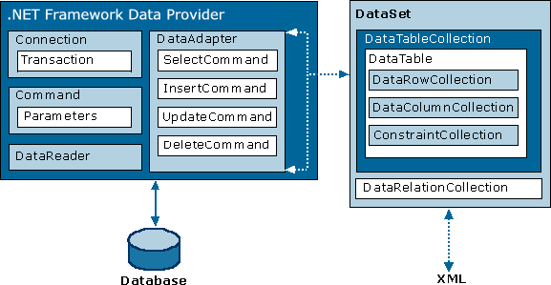
ADO.NET Architecture
ADO.NET uses a multilayered architecture that revolves around a few key concepts, such as Connection, Command, and DataSet objects.

Slide 7
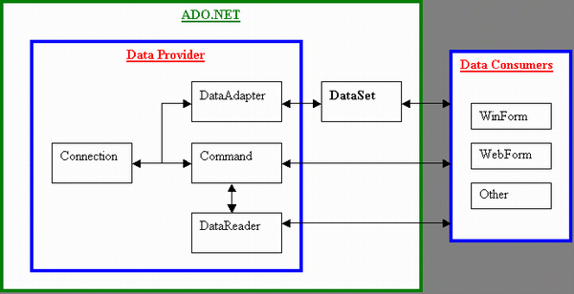
ADO.NET Architecture
ADO.NET allows you to write the data access code in web applications that you write for
  client-server desktop applications, or
  single-user applications that connect to a local database.

Slide 8
ADO.NET Data Providers
Connection
To establish a connection to a data source.
Command
To execute SQL commands and stored procedures.
DataReader
This object provides fast read-only, forward-only access to the data retrieved from a query.
DataAdapter
To fill a DataSet with information extracted from a data source.
To apply changes to a data source, according to the modifications you’ve made in a DataSet.

Slide 9
ADO.NET Data Providers
SQL Server provider: Provides optimized access to a SQL Server database
OLE DB provider: Provides access to any data source that has an OLE DB driver such as MS Access, MySQL
Oracle provider: Provides optimized access to an Oracle database
ODBC provider: Provides access to any data source that has an ODBC driver.

Slide 10
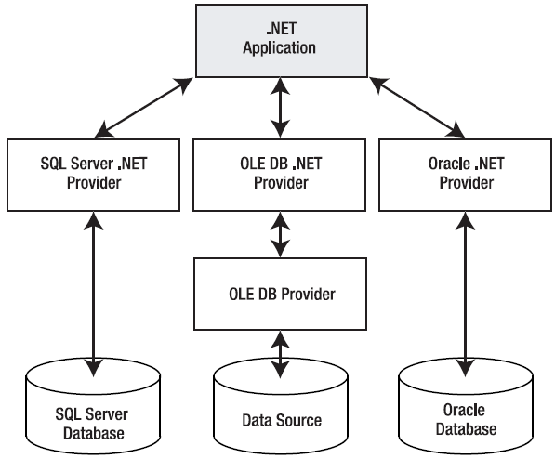
ADO.NET Data Providers
The layers of the ADO.NET provider model

Slide 11
The ADO.NET Namespace
Namespace | Description
System.Data | Contains the key data container classes that model columns, relations, tables, datasets, rows, views, and constraints.
System.Data.OleDb | Contains the classes used to connect to an OLE DB provider, including OleDbCommand, OleDbConnection, OleDbDataReader, and OleDbDataAdapter.
System.Data.SqlClient | Contains the classes you use to connect to a Microsoft SQL Server database, including SqlCommand, SqlConnection, SqlDataReader, and SqlDataAdapter.
System.Data.OracleClient | Contains the classes required to connect to an Oracle database, including OracleCommand, OracleConnection, OracleDataReader, and OracleDataAdapter.
System.Data.Odbc | Contains the classes required to connect to most ODBC drivers, including OdbcCommand, OdbcConnection, OdbcDataReader, and OdbcDataAdapter.

Slide 12
Connection Strings
The connection string is a series of name/value settings separated by semicolons (;).
It specifies the basic information needed to create a connection.
The order of these settings is unimportant, as is the capitalization.
Three parts:
  The server where the database is located
  The database you want to use
  How the database should authenticate you
Example:
  "Data Source=localhost; Initial Catalog=Northwind; Integrated Security=SSPI"

Slide 13
Connection Strings
Logged-in Windows user:
  "Data Source=localhost; Initial Catalog=Northwind; Integrated Security=SSPI"
SQL Server EXPRESS database
"Data Source=localhost\SQLEXPRESS; Initial Catalog=Northwind; Integrated Security=True"
SQL Server database, the sa (system administrator) account
"Data Source=localhost; Initial Catalog=Northwind; user id=sa; password=de"
Connects to an Access database file
"Provider=Microsoft.Jet.OLEDB.4.0; Data Source=C:\DS\Northwind.mdb"
Supply the file name of the database in the App_Data directory
"Data Source=localhost\SQLEXPRESS; Integrated Security=SSPI; AttachDBFilename=Northwind.mdf; User Instance=True""

Slide 14
Testing a Connection
1. Define the connection string
2. Use Open() and Close() methods (manage the connection)
string connectionStr = "Data Source=localhost\\SQLEXPRESS;
Initial Catalog=OtelDB;
Integrated Security=True";
SqlConnection con = new SqlConnection(connectionStr);
con.Open();
con.Close();

Slide 15
Connection Pooling
Acquiring a connection takes a short, but definite, amount of time.
Connections will be opened and closed endlessly as new requests are processed.
Problem: limit the scalability of the system
Solution: connection pooling

Slide 16
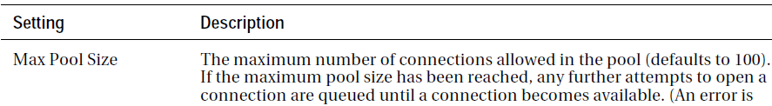
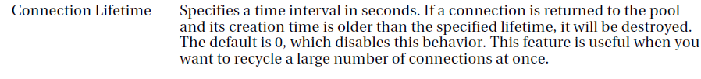
Connection Pooling
Connection pooling is the practice of keeping a permanent set of open database connections.
ClearPool() is also possible.
string connectionStr = "Data Source=localhost; Initial
Catalog=Northwind;
Integrated Security=True;
Max Pool Size=1000";
SqlConnection con = new SqlConnection(connectionStr);
con.Open();
con.Close();

Slide 17
The Command Class
The Command class allows you to execute any type of SQL statement.
It is used to perform
  data definition tasks
    such as creating and altering databases, tables, and indexes
  data manipulation tasks
    such as retrieving and updating the records in a table

Slide 18

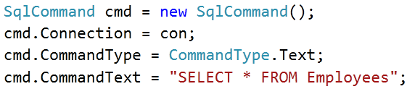
Command Basics
Before you can use a command
  Choose the CommandType
  Set the CommandText
  Bind the command to a Connection.
Example 1:
Example 2:

Slide 19
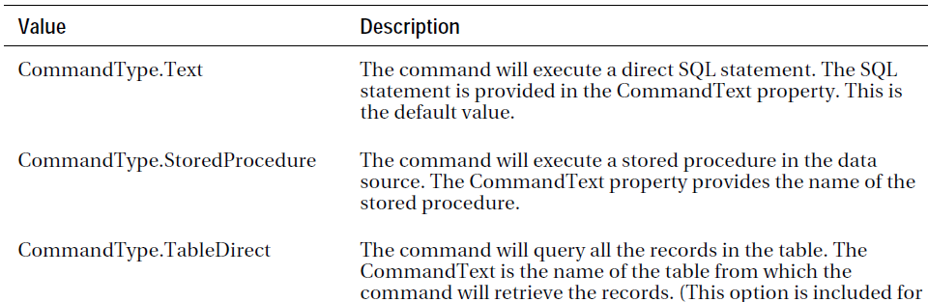
Command Types

Slide 20
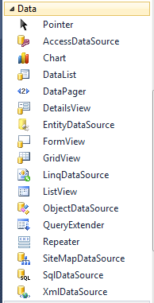
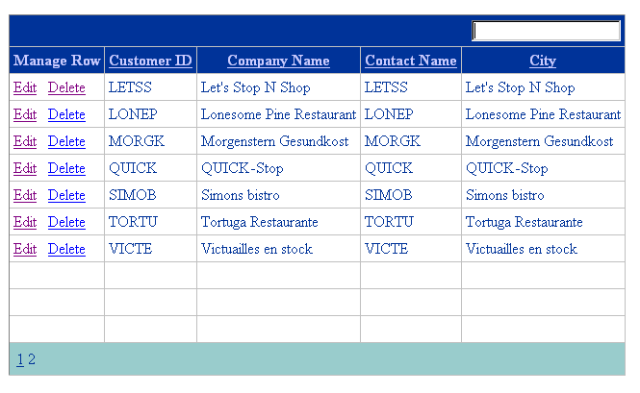
GridView
Grid control for showing large tables of information.
It supports selecting, editing, sorting, and paging.
It provides a
  DataSource property for the data object and
  DataBind() method that triggers it to read the data object and display each record.

Slide 21
Command Methods
Three methods to execute a command:
ExecuteNonQuery()
Executes non-SELECT commands, such as SQL commands that insert, delete, or update records.
ExecuteScalar()
Executes a SELECT query and returns a single value such as COUNT() or SUM()
ExecuteReader()
Executes a SELECT query and returns a full result set.

Slide 22
ExecuteReader()
string connectionStr = "Data Source=localhost\\SQLEXPRESS;
Initial Catalog=OtelDB;
Integrated Security=True";
SqlConnection con = new SqlConnection(connectionStr);
con.Open();
SqlCommand cmd = new SqlCommand(connectionStr,con);
cmd.CommandText = "SELECT * FROM Oteller";
SqlDataReader reader = cmd.ExecuteReader();
GridView1.DataSource = reader;
GridView1.DataBind();
con.Close();

Slide 23
ExecuteScalar()
string connectionStr = "Data Source=localhost\\SQLEXPRESS;
Initial Catalog=OtelDB;
Integrated Security=True";
SqlConnection con = new SqlConnection(connectionStr);
con.Open();
SqlCommand cmd = new SqlCommand(connectionStr, con);
cmd.CommandText = "SELECT COUNT(*) FROM Oteller";
Label1.Text= cmd.ExecuteScalar().ToString();
con.Close();

Slide 24
ExecuteNonQuery()
string connectionStr = "Data Source=localhost\\SQLExpress;
Initial Catalog=OtelDB;
Integrated Security=True";
SqlConnection con = new SqlConnection(connectionStr);
con.Open();
SqlCommand cmd = new SqlCommand(connectionStr,con);
cmd.CommandText = "INSERT INTO Oteller VALUES ('" + TextBox1.Text + "',
'" + TextBox2.Text + "',
'" + TextBox3.Text + "',
'" + TextBox4.Text + "',
'" + TextBox5.Text + "')";
cmd.ExecuteNonQuery();
con.Close();
Response.Redirect("default.aspx"); //refresh

Slide 25
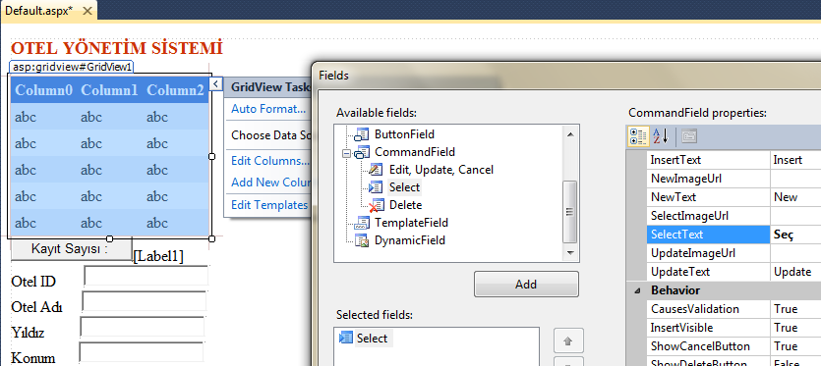
GridView
Adding SELECT column to the GridView

Slide 26
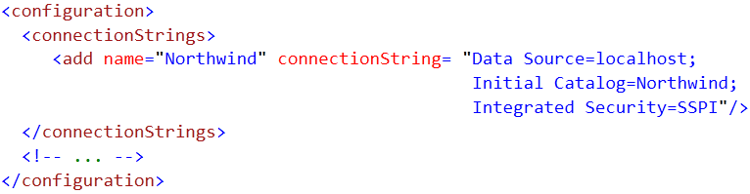
Global Connection Strings
Store the connection strings in web.config file
Retrieve it using WebConfigurationManager.ConnectionStrings

Slide 27
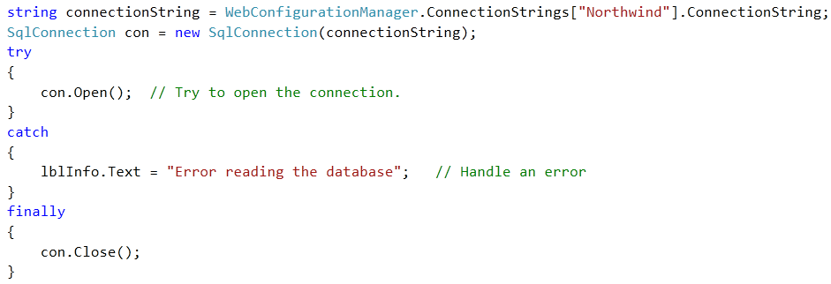
Handling Connection Errors
1. Define the connection string
2. Use Open() and Close() methods (manage the connection)
Web.config file

Slide 28
App_Data
Website ➤ Add New Item ➤ SQL Server Database
Choose a file name for your database, and click OK.
The .mdf and .ldf files for the new database will be placed in the App_Data folder.
Double click the .mdf file in the Solution Explorer.
Using the Server Explorer, you can create tables, edit data, and execute commands, all without leaving the comfort of Visual Studio.

Slide 29
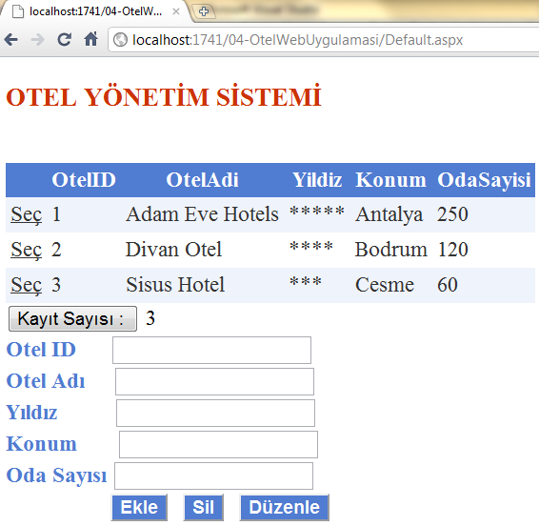
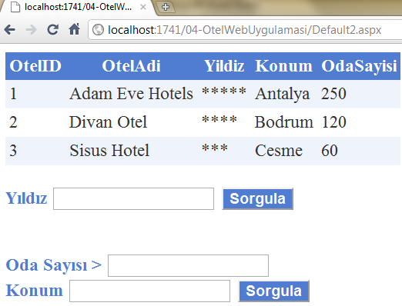
Let’s do It

Slide 30
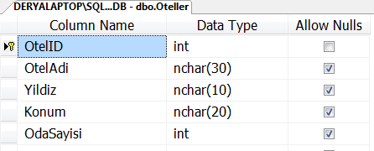
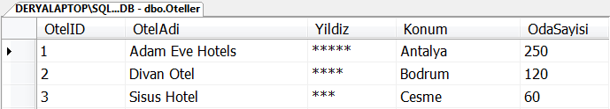
Let’s do It

Slide 31

See you next week!
Asst.Prof.Dr.Derya BİRANT
328 - Web Based Windows Programming

